Slide 1
Optometry Grand rounds
18/4/18
Stephen lash
BM, BSc(Hons), MCOptom, FRCOphth, MBA
Consultant Ophthalmic Surgeon UHS

Slide 2
The case
56 female
Flashing lights

Slide 3
First thoughts?

Slide 4
History

Slide 5
Examination?

Slide 6
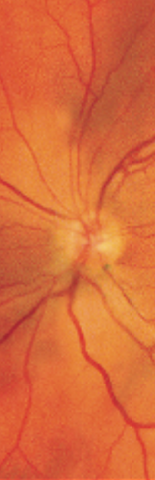
Examination

Slide 7
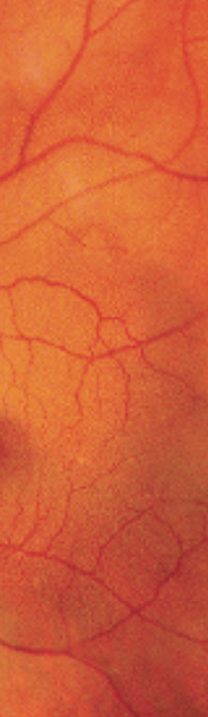

Slide 8
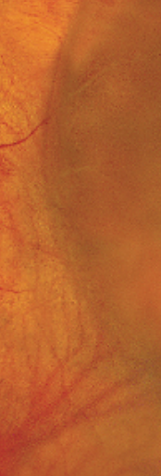

Slide 9
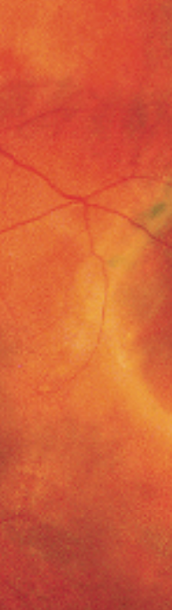

Slide 10
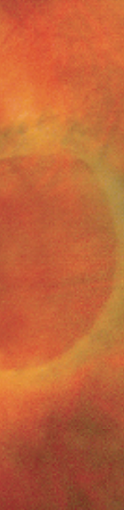

Slide 11
Diagnosis and differential diagnosis?

Slide 12
Outcome?

